Slide 1
Hooper AI
A Multimodal Sports Performance Assistant
GOOGLE ADK PROJECT BY JEAN OBUYA

Slide 2
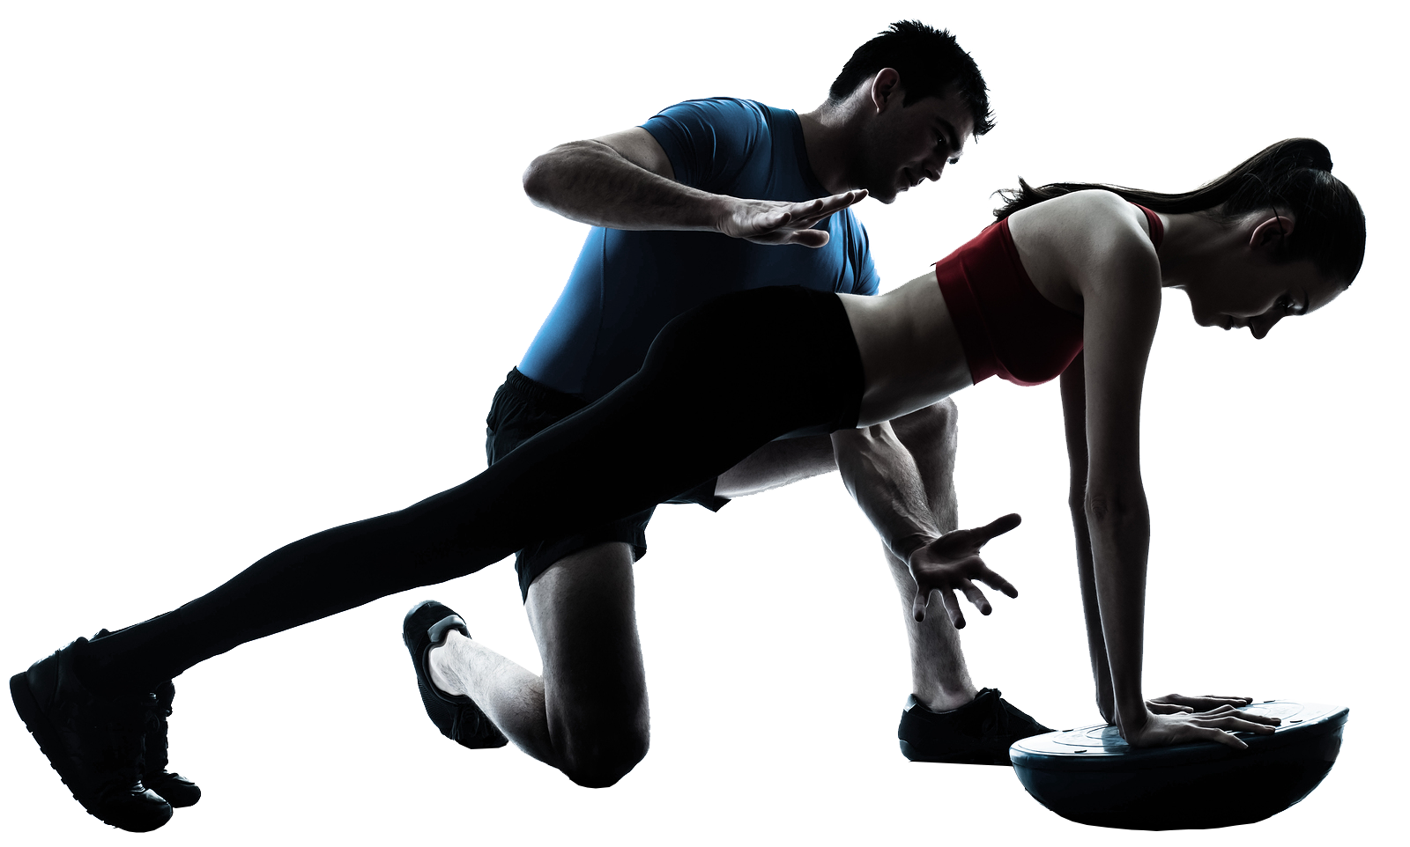
Project overview
Hooper AI is an advanced sports performance assistant designed to support athletes across every aspect of their development. It brings together mental, physical, nutritional, and tactical guidance into one unified system powered by multiple specialized agents. By understanding the athlete’s needs and providing tailored insights, Hooper AI helps create structure, improve consistency, and elevate overall performance through an intelligent, multimodal approach.

Slide 3
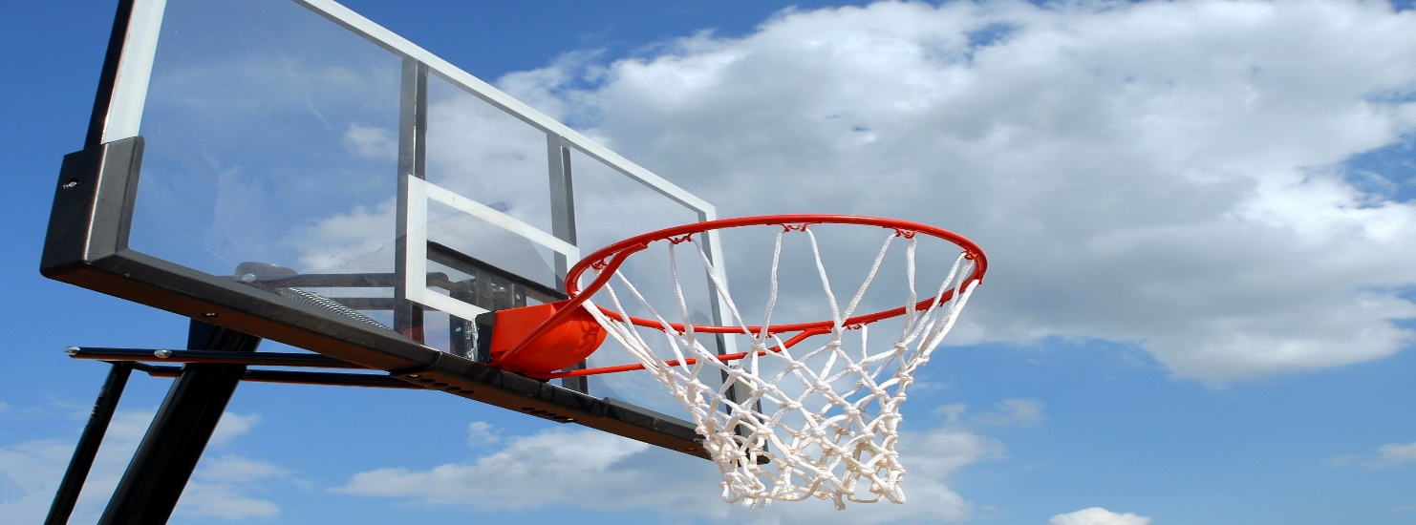
CORE AGENTS
Hooper AI is built around several dedicated agents, each designed to address a specific area of athlete growth. The Faith & Mental Agent strengthens focus, motivation, and emotional resilience. The Drills Agent recommends personalized YouTube drills based on weaknesses. The Fitness Agent delivers nutrition advice, workout planning, Kenyan recipes, recovery guidance, and Google Calendar scheduling. The Play Analysis Agent improves basketball IQ through strategy explanations powered by RAG. Finally, the AlloyDB/Analytics Agent uses Kobe Bryant’s career data and natural-language-to-SQL querying to offer smart decision-making insights.

Slide 4
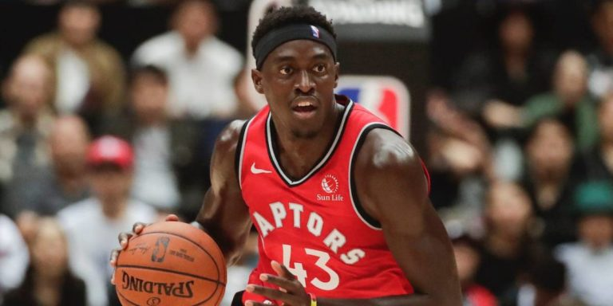
KEY FUNCTIONALITIES
Vertex AI Memory Bank: Stores user preferences and progress
RAG-Powered Knowledge Retrieval: Curated insights from datasets
Weather & Location Awareness: Tailored recovery & training guidance
Google Calendar Integration: Automates workouts and meal-prep events
Natural Language Database Querying (NL2SQL): Query historical data effortlessly
YouTube Drill Recommendations: Personalized skill-based drills
Nutrition & Recovery Guidance: Hydration tips, Kenyan recipes, recovery plans
Workout Planning & Scheduling: Structured training routines
Play Analysis (RAG): Strategy breakdowns and drill suggestions
1
Vertex AI memory
The Agent is able to remember the user’s relevant information using vertex AI memory bank
2
Fitness Advice
Hooper AI provides personalized fitness guidance, including workouts, nutrition, recovery, hydration, Kenyan recipes, and weather-aware recommendations for optimal performance.

Slide 5
IMPACT TO AFRICAN SPORTS
Hooper AI transforms the way athletes train by providing structure, clarity, and personalized support. It helps athletes make smarter decisions, build stronger routines, and consistently improve both their physical and mental performance. With tailored drills, nutrition plans, strategic insights, and continuous memory, Hooper AI acts as a comprehensive companion throughout the athlete’s journey. The system’s holistic design ensures athletes receive meaningful, actionable guidance that elevates their game and supports long-term development.

